Slide 1
NEAR STORE
Presenter: Huu Thang
Course: NEAR Certified Developer Level 1
1
NEAR STORE - (NFT IS UNDER DEVELOPMENT)
2
IMPLEMENTATION
3
DEMO
4
DISCUSSION

Slide 2
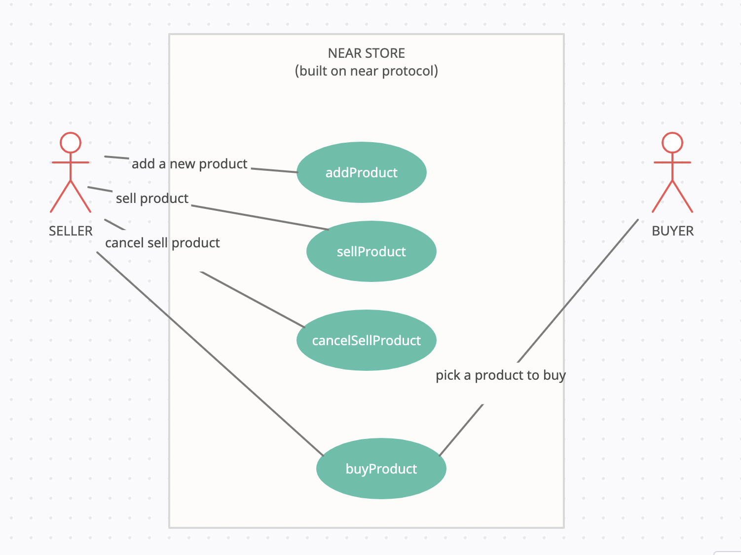
1. NEAR STORE
IDEA: BUILD A STORE BASE ON NEAR BLOCKCHAIN (NFT is under development)
Description: The place where user can buy or sell their own products.
Source code: https://github.com/nguyenhuuthangwkr/Near-Store.git
Demo: https://1234-red-wasp-3dayp0qz.ws-us18.gitpod.io

Slide 3
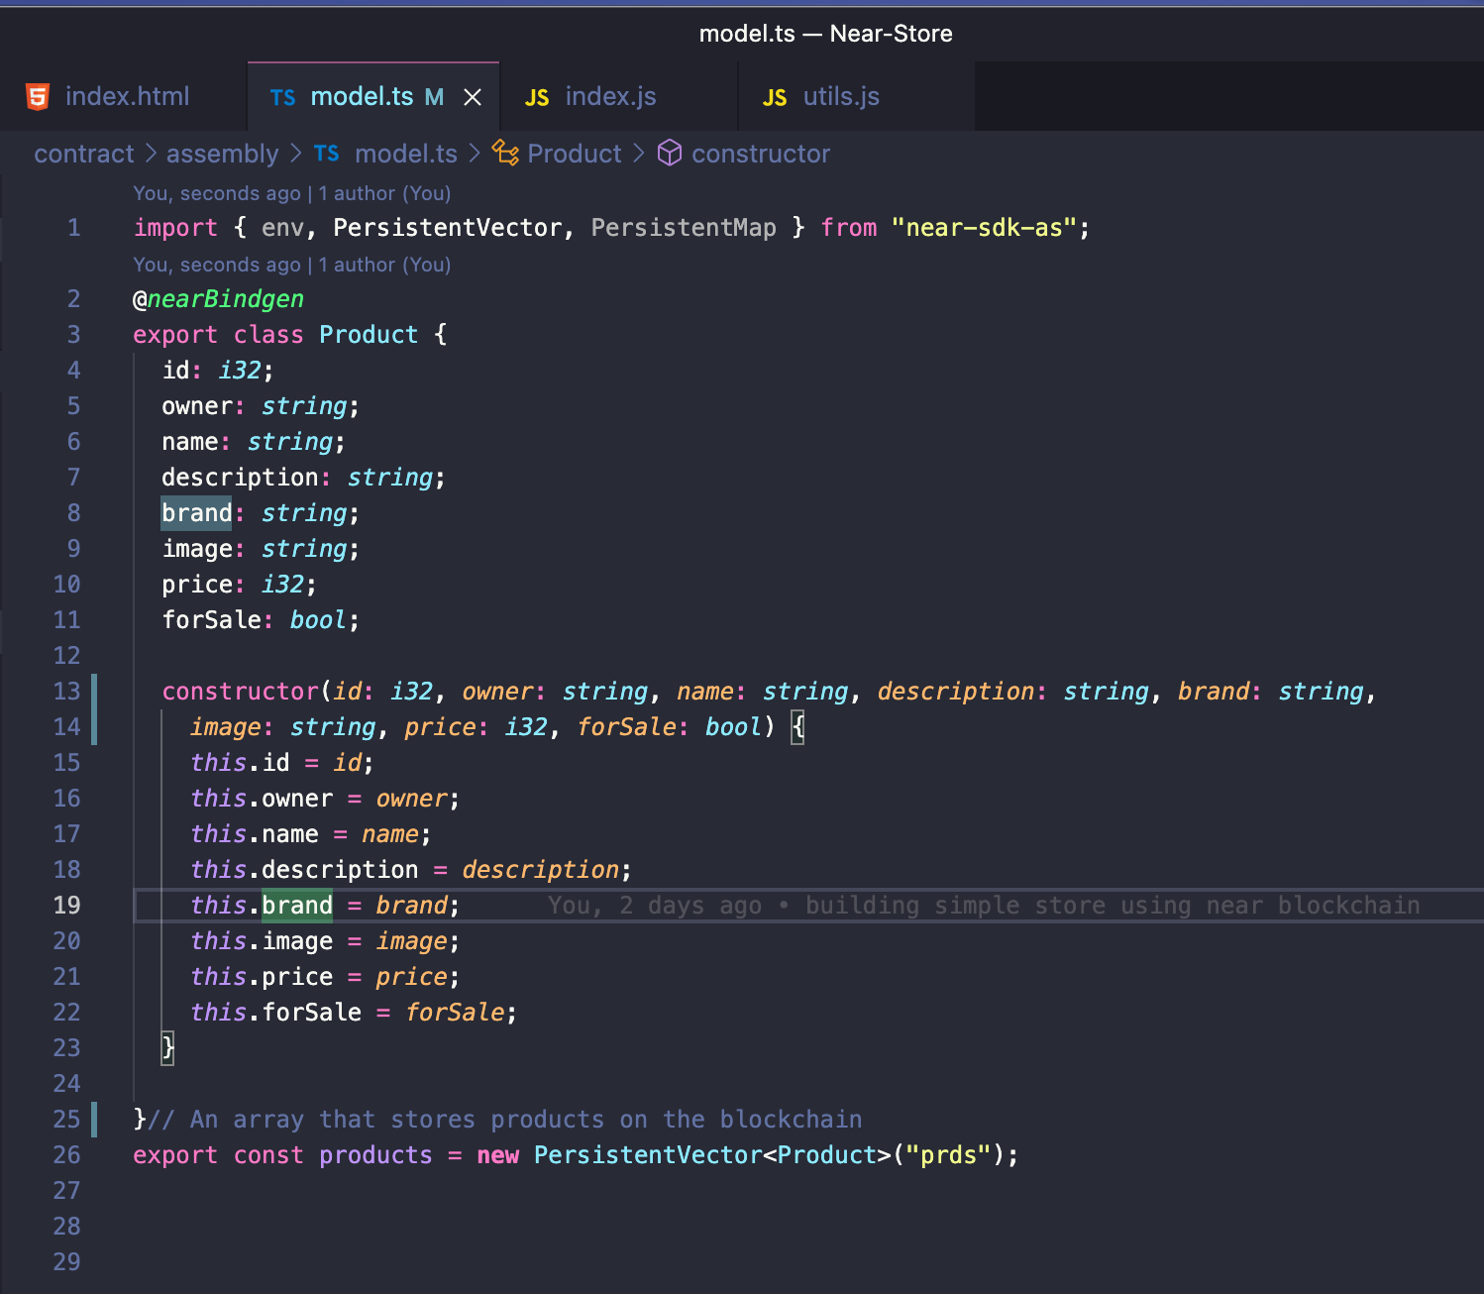
2. IMPLEMENTATION
MODEL.TS
Define Product data structure and declare variables to store data on NEAR blockchain.

Slide 4
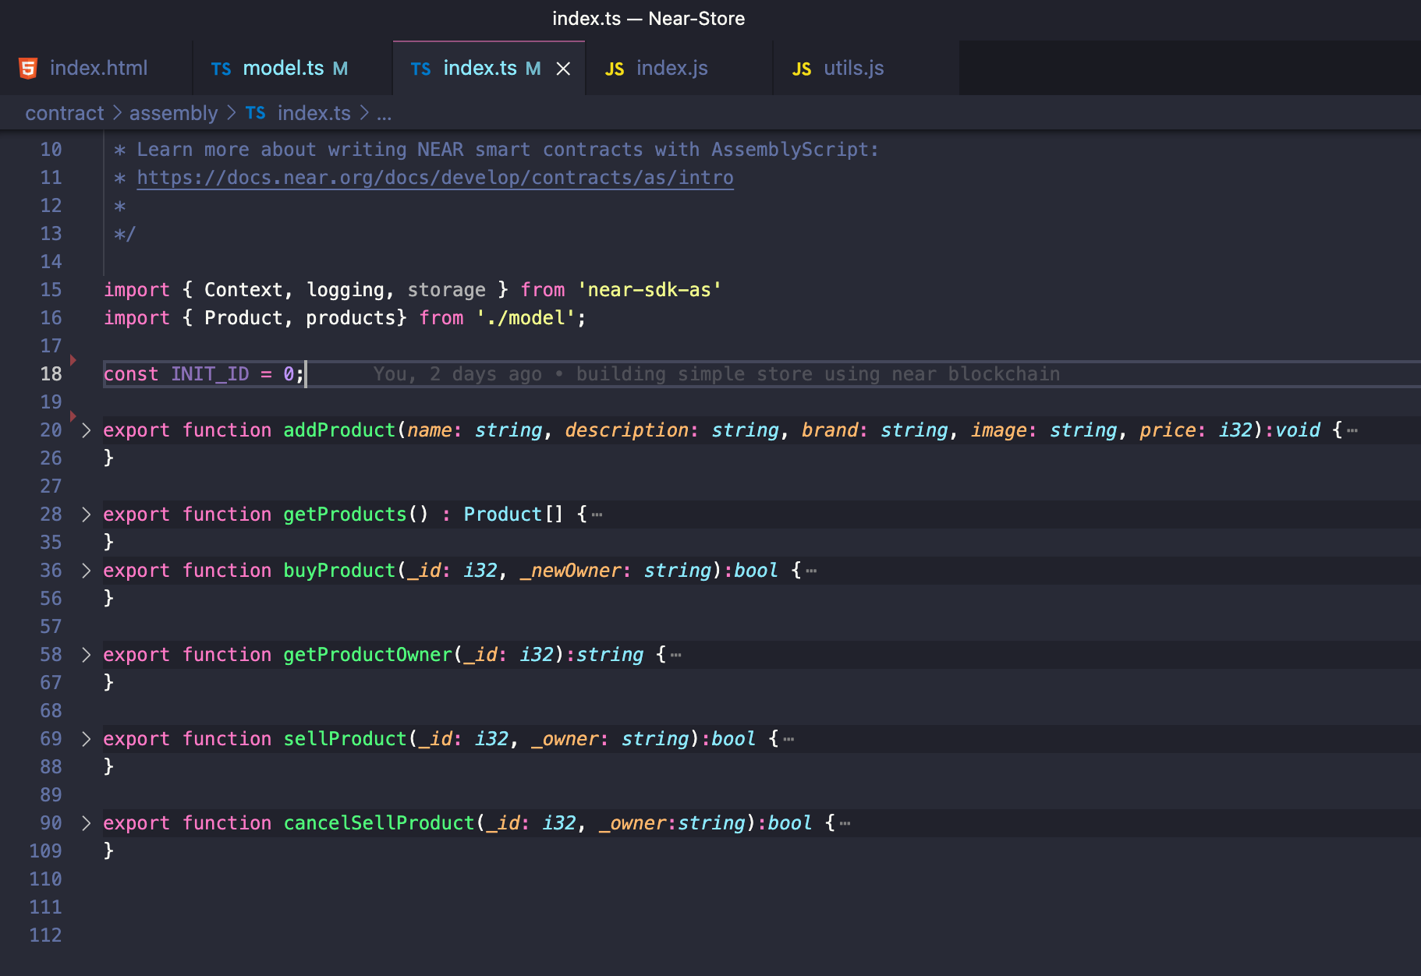
2. IMPLEMENTATION
INDEX.TS
Provide 6 functions to help clients manipulate data on Smart Contract

Slide 5
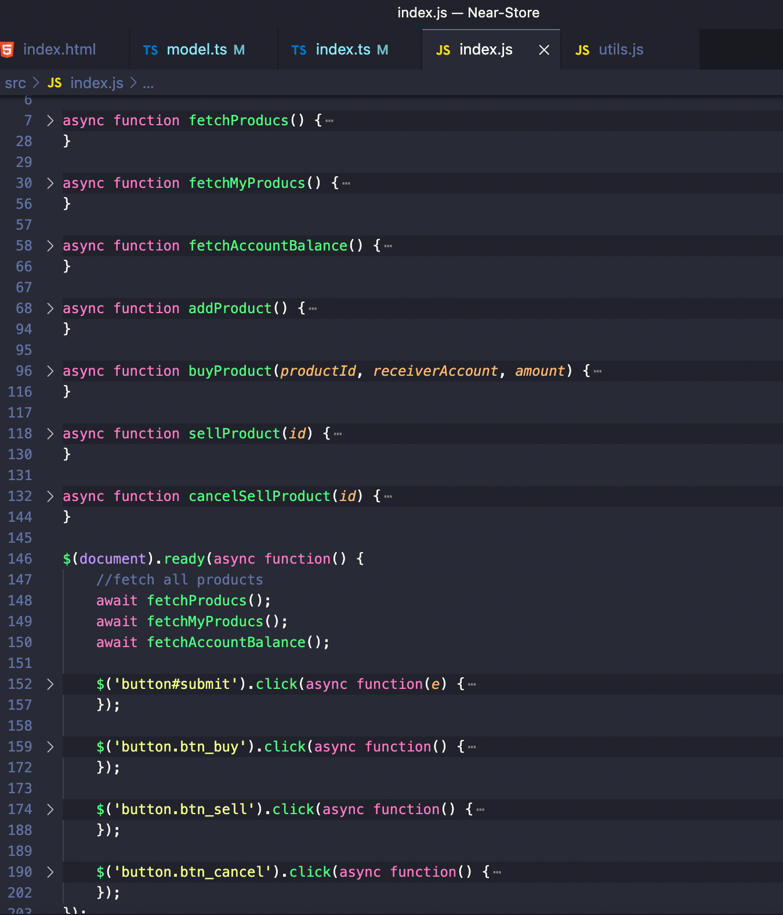
2. IMPLEMENTATION
INDEX.JS
Provide somes functions to receive data from blockchain then display to front end

Slide 6
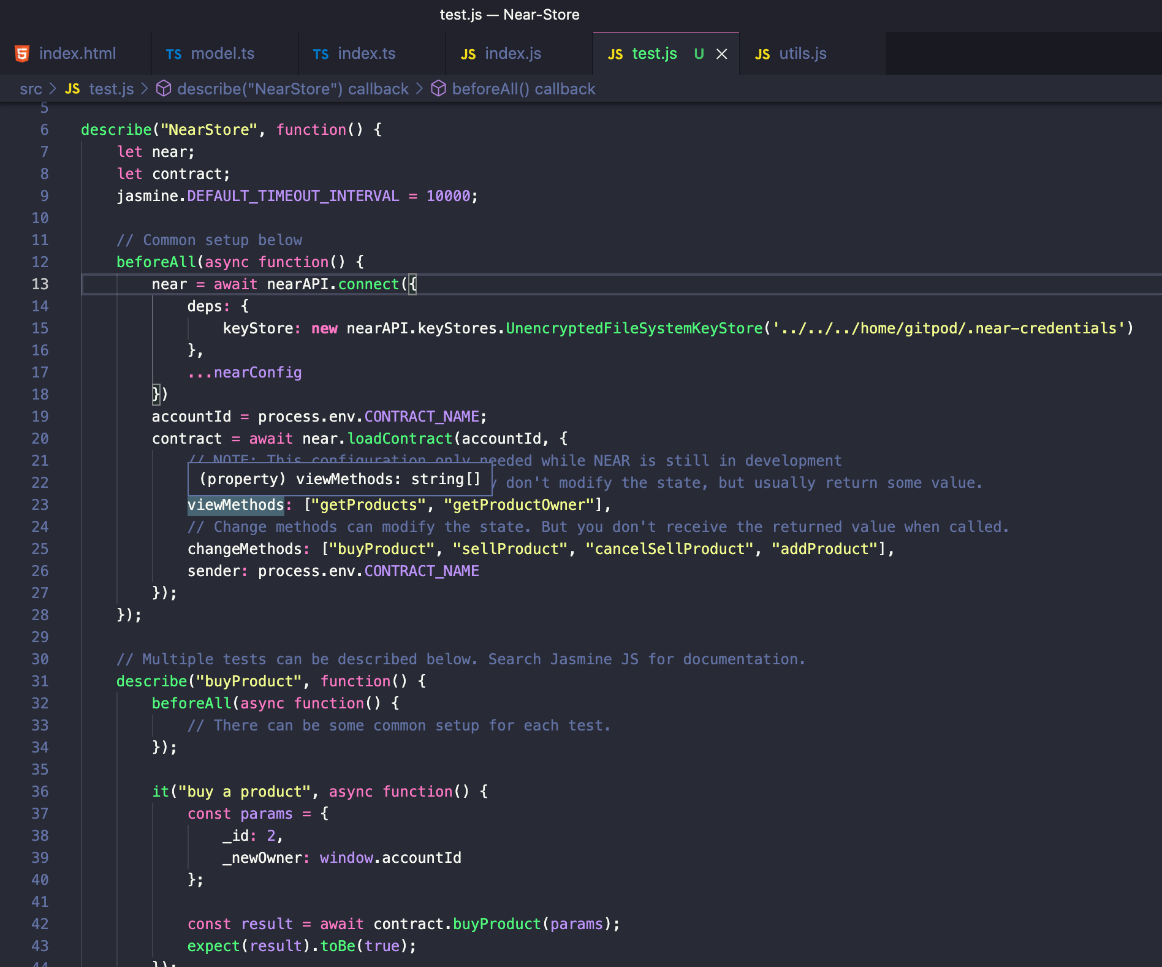
2. IMPLEMENTATION
TEST CASE
BUY PRODUCT TESTCASE

Slide 7
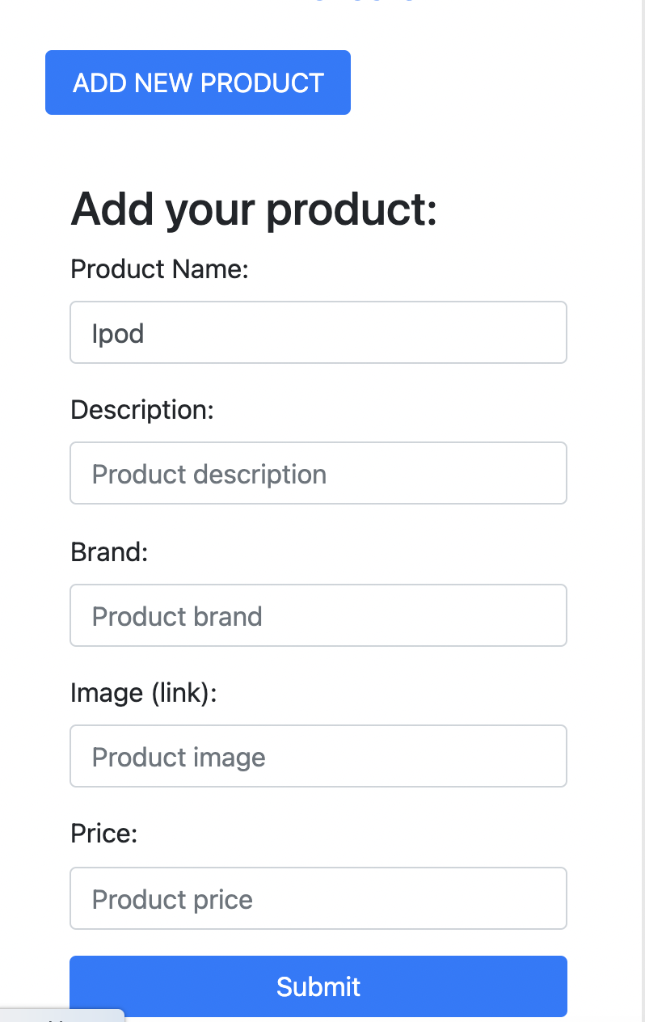
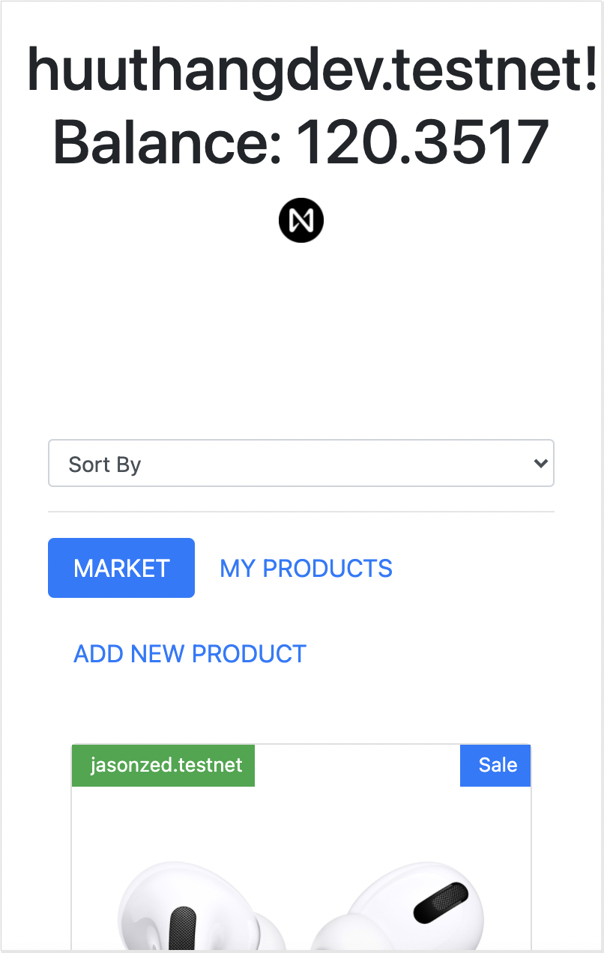
3. DEMO
Run Test
yarn jest
Run Demo
yarn dev

Slide 8
4. DISCUSSION
WHAT NEEDS IMPROVEMENT?
  Need to improve security for buying and selling transaction
  Fix layout display problems
FUTURE EXPECTATIONS?
  Add NFT market for the store
  The solutions:
    Content is store on IPFS encrypted with a symmetric key
    Build NFT module base on NEAR example contract
    NEAR blockchain only store header data and a symmetric key encrypted public key.

Slide 9
Thank you for listening

